Slide 1
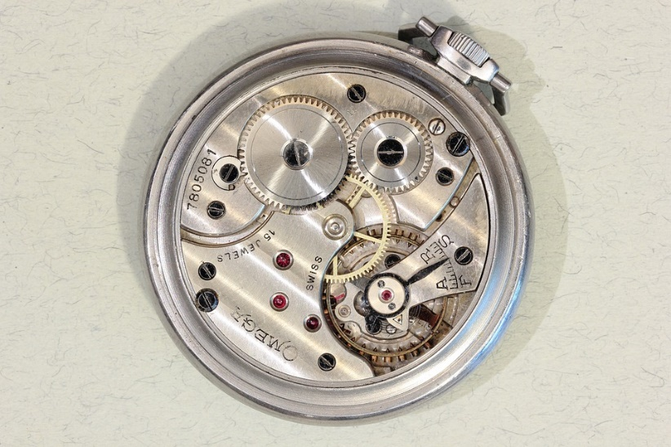
Horology and Watchmaking vocabulary
CCO
ODT/ CAP horloger, GHD Morteau 2018 A. Romand Copyright

Slide 2
Horology vs. Watch- or Clockmaking
Horology: « the sudy of time » Wikipédia: is the art and/or science of measuring time.
Clocks, watches, clockwork, sundials, hourglasses, clepsydras, timers, time recorders, marine chronometers and atomic clocks are all examples of instruments used to measure time.

Slide 3
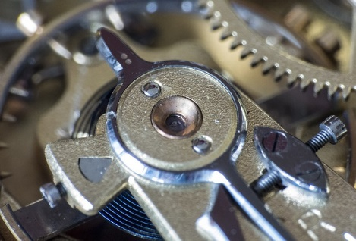
HOROLOGY
In current usage, horology refers mainly to the study of mechanical time-keeping devices, while chronometry more broadly includes electronic devices that have largely supplanted mechanical clocks for the best accuracy and precision in time-keeping.
People interested in horology are called horologists. That term is used both by people who deal professionally with timekeeping apparatus (watchmakers, clockmakers
CCO

Slide 4
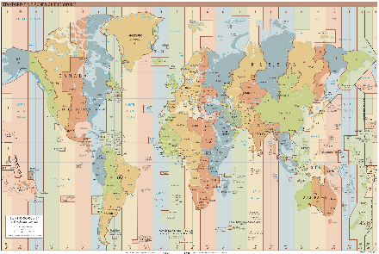
FUSEAUX HORAIRES & COORDONEES
RAPPEL: Coordinated Universal Time=UTC, primary civil time standard nowadays, based on highly precise atomic clocks combined with earth’s rotation
MERIDIAN méridien
LONGITUDE longitude, @20°longitude North/South/East/West
LATITUDE latitude =>to be free to do what one wants

Slide 5
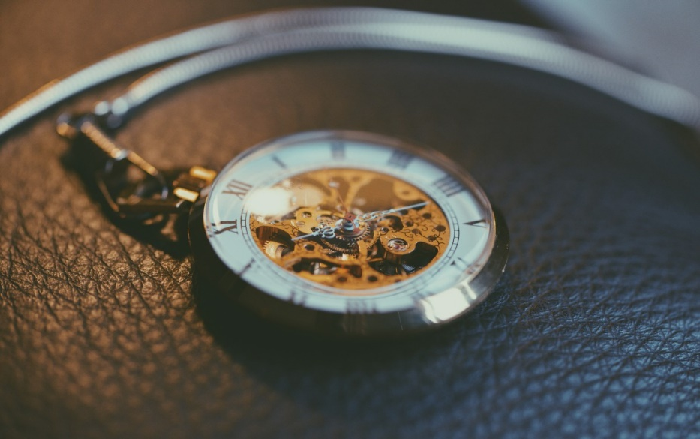
AFFICHAGE
The DiAL and the HANDS: Le cadran et les aiguilles (sens aiguille d’une montre: Clockwise/anticlockwise)
LC Liquid Crystals: Crystaux liquides
CCO

Slide 6
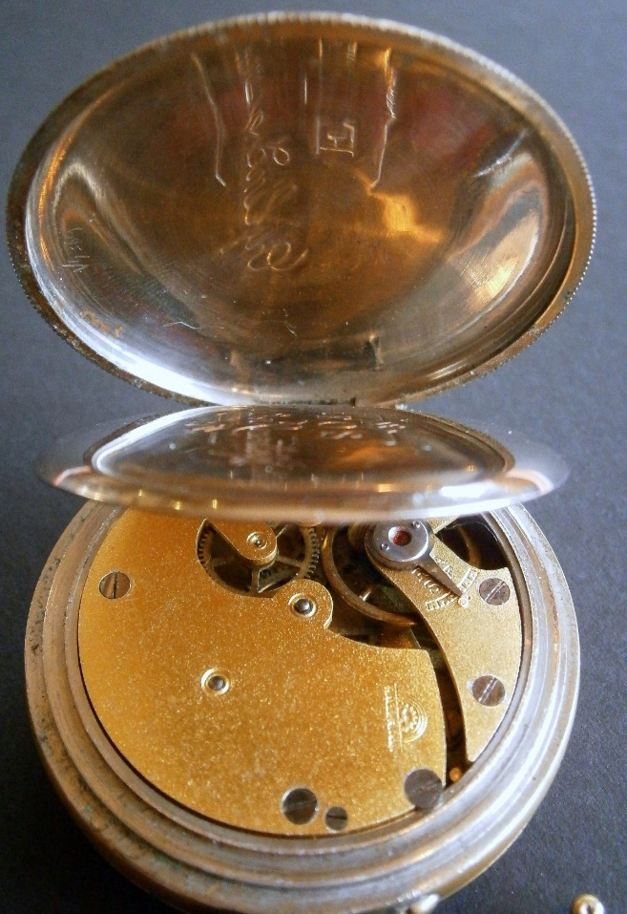
Le mouvement mécanique simple
The movement (or the caliber): Le mouvement
The dial and the hands (small/big): Le cadran et les aiguilles
The case: Le boitier
CCo

Slide 7
A LOT of French terms!
CCO
CCO
Chablon French term for a watch movement (not including the dial and hands), that is not completely assembled.
Ébauche French term (commonly used in English-speaking countries) for a movement blank, i.e., an incomplete watch movement sold as a set of loose parts—comprising the main plate, bridges, train, winding and setting mechanism, and regulator. The timing system, escapement, and mainspring, however, are not parts of the ébauche.
Établissage French term for the method of manufacturing watches or movements by assembling their various components. It generally includes the following operations: receipt, inspection and stocking of the "ébauche", the regulating elements and the other parts of the movement and of the make-up; assembling; springing and timing; fitting the dial and hands; casing; final inspection before packing and dispatching.
Établisseur French term for a watch factory that assembles watches from components it buys from other suppliers.
Factory, works In the Swiss watch industry, the term manufacture is used of a factory that manufacturers watches almost completely, as distinct from an atelier de terminage, which only assembles, times, and fits hands and casing.
Manufacture d'horlogerie French term for a watch factory that produces components (particularly the "ébauche") for its products (watches, alarm and desk clocks, etc.).
Terminage French term denoting the process of assembling watch parts for the account of a producer.
Termineur French term for an independent watchmaker (or workshop) engaged in assembling watches, either wholly or in part, for the account of an "établisseur" or a "manufacture", who supply the necessary loose parts. See "atelier de terminage" above.

