Slide 1
Women’s rights

Slide 2
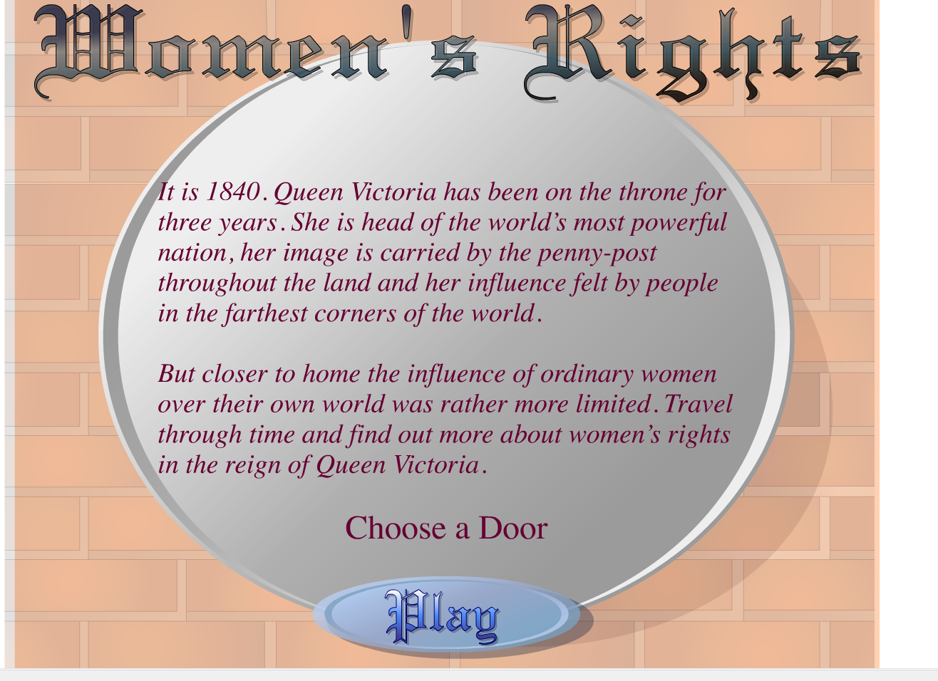

Slide 3
Children
In 1839 ,the Custody of Infants Act was passed which allowed women to clain custody of young children following separation,
All the other rights were denied to women.

Slide 4
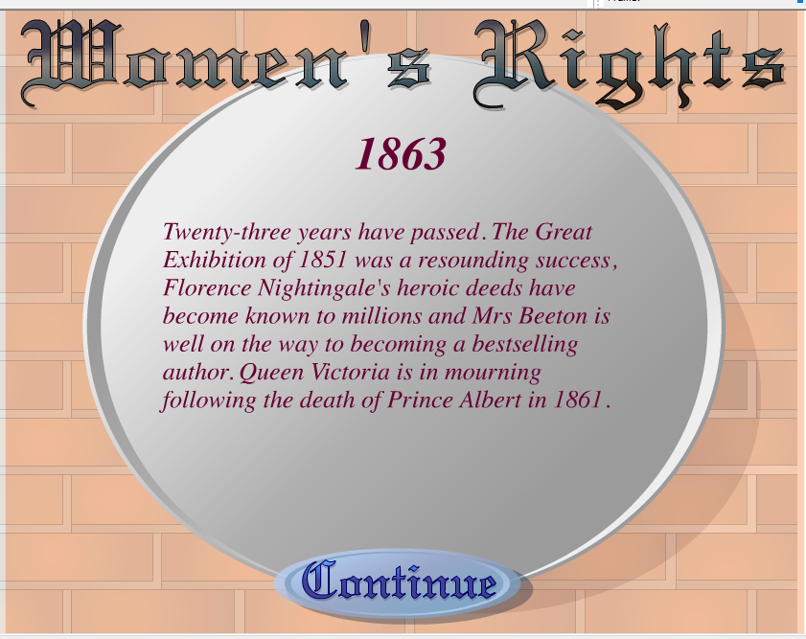

Slide 5
1863
Divorce :The Matrimonial Causes Act of 1857 introduced the possibility of a civil divorce, one which could be granted without an Act of Parliament.
Money : The Matrimonial Causes Act of 1857 allowed legally separated women to retain their earnings, giving them some control over their own income for the first time.

Slide 6
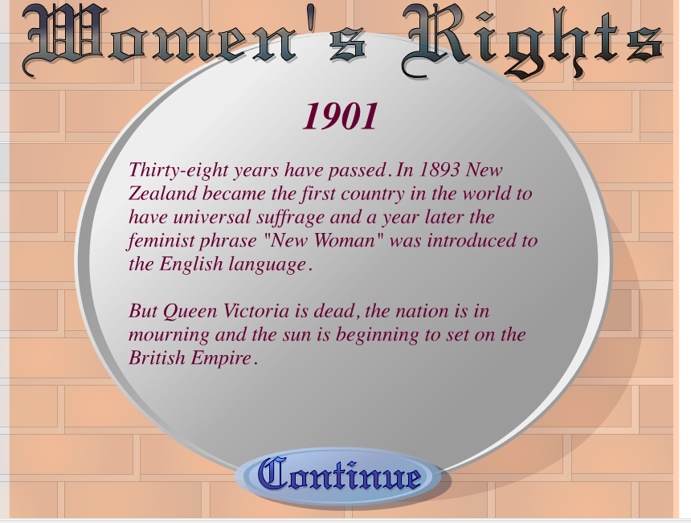

Slide 7
1901
Job : The Lonfon School of Medicine for Women was founded in 1874 for the medical education of women.
Studies : In 1878, London University was the first to award women degrees on the same terms as men

Slide 8
