Slide 1
Christmas in Saint Lucia

Slide 2
Festival of Lights:
The Festival of Lights is an annual celebration that marks the start of the Christmas season. Local residents and travellers make all sorts of lanterns in unique shapes and a variety of colours and put them on display.
“Transportation – Modern by man” by Ciceron RC Combined
Notes:
See more at: http://community.elegantresorts.co.uk/st-lucia-at-christmas-caribbean-luxury/#sthash.Bm9ogOcz.dpuf

Slide 3
Local Traditions:
‘Bamboo Bursting’ is a local tradition in Saint Lucia. Bamboo gets snapped in the night as a way to symbolise the coming holiday.
On Christmas Eve, many residents attend a Christmas service at church and then end the night at parties with friends and family.
Notes:
http://tropicaltraveller.com/content/cultural-celebration-bamboo-bursting/
See more at: http://community.elegantresorts.co.uk/st-lucia-at-christmas-caribbean-luxury/#sthash.Bm9ogOcz.dpuf

Slide 4
Specialty Christmas Foods:
A typical Christmas meal in St. Lucia might include a roasted ham or turkey, lots of ground provisions and a refreshing ginger beer to drink. For dessert, the local specialty is fruitcake. The fruits are typically soaked in a local red wine for more than three months to develop a spicy and rich flavor.
Notes:
See more at: http://community.elegantresorts.co.uk/st-lucia-at-christmas-caribbean-luxury/#sthash.Bm9ogOcz.dpuf

Slide 5
Christmas Ham
Christmas Turkey

Slide 6
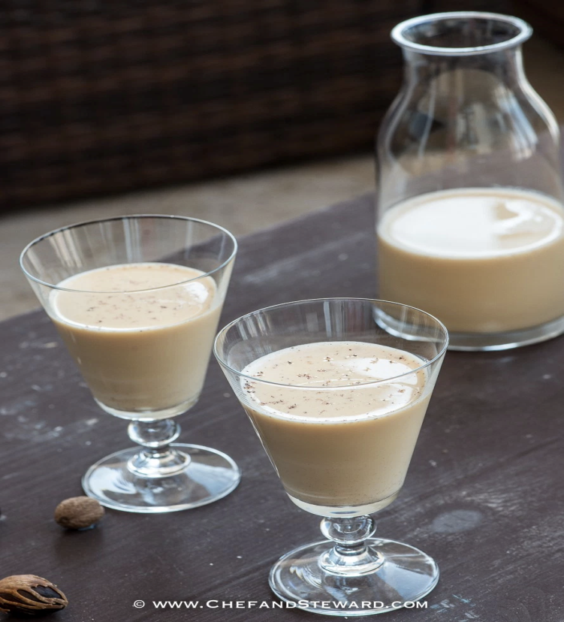
Eggnog
Ginger beer

Slide 7
Cow Heel Soup
Ground Provisions

Slide 8
Fruitcake
Sorrel

Slide 9
Music:
‘Poinsettia Blossom’ performed by Tru Tones & Emerson Nurse
‘Merry Christmas, Saint Lucian Style’ performed by
Pele
"Poinsettia Blossoms" is a song written by Charles Cadet about a love lost at Christmas. It has become a St. Lucian Christmas classic.
‘Twadisyon Noel’ performed by
Pele

