Slide 1
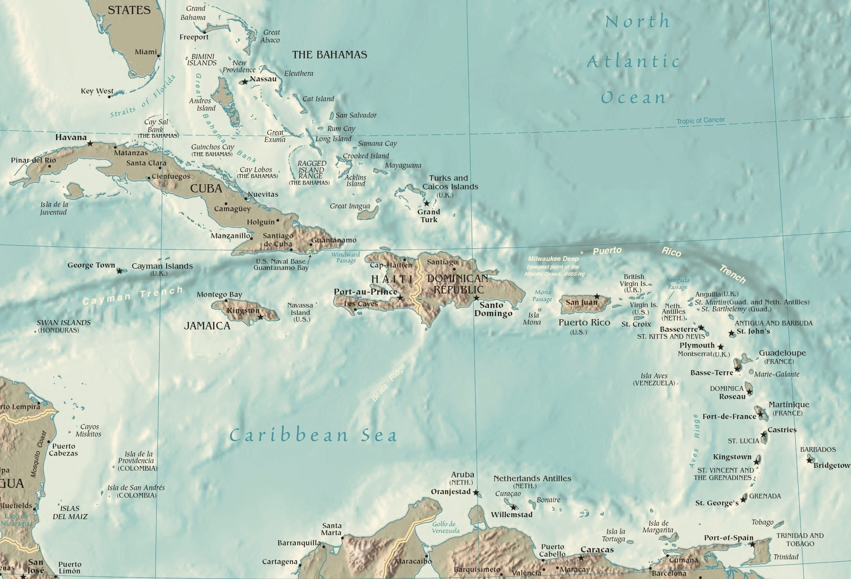

Slide 2
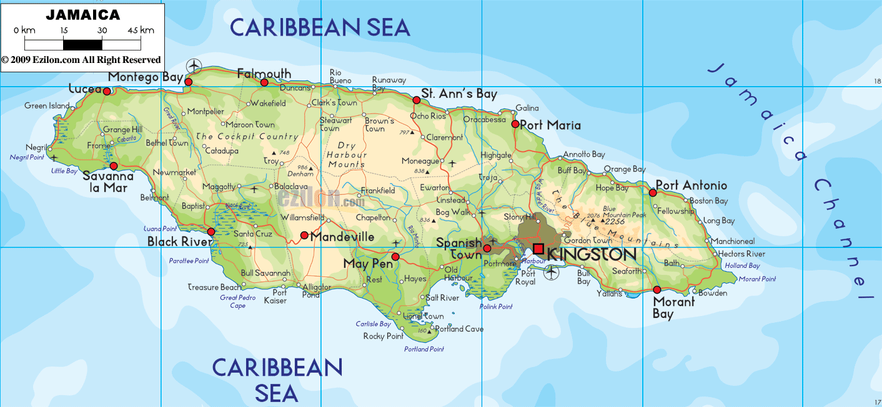
The capital of Jamaica is Kingston.

Slide 3
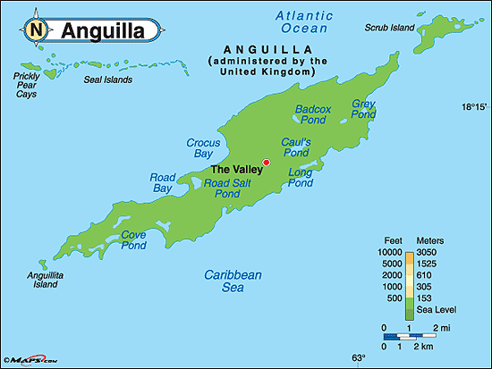
The capital of Anguilla is The Valley.

Slide 4
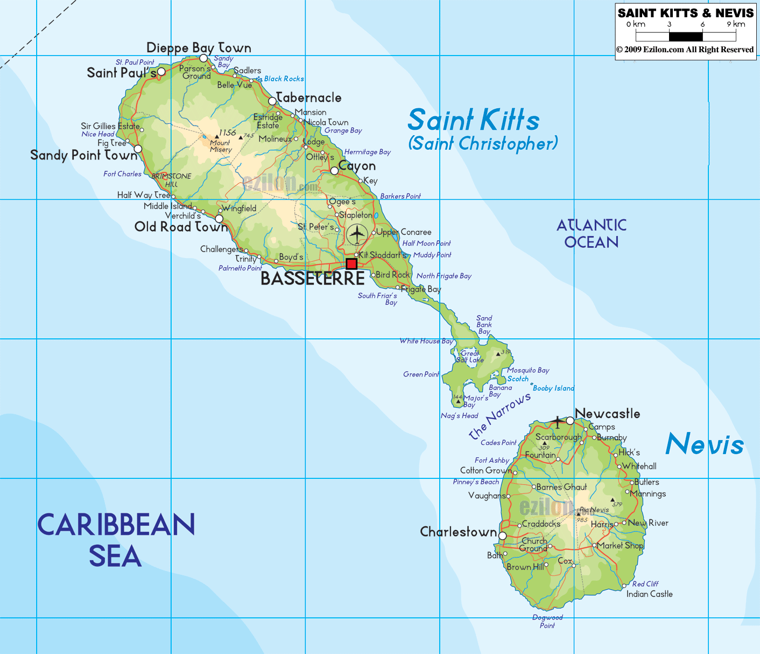
The capital of St. Kitts & Nevis is Basseterre.

Slide 5
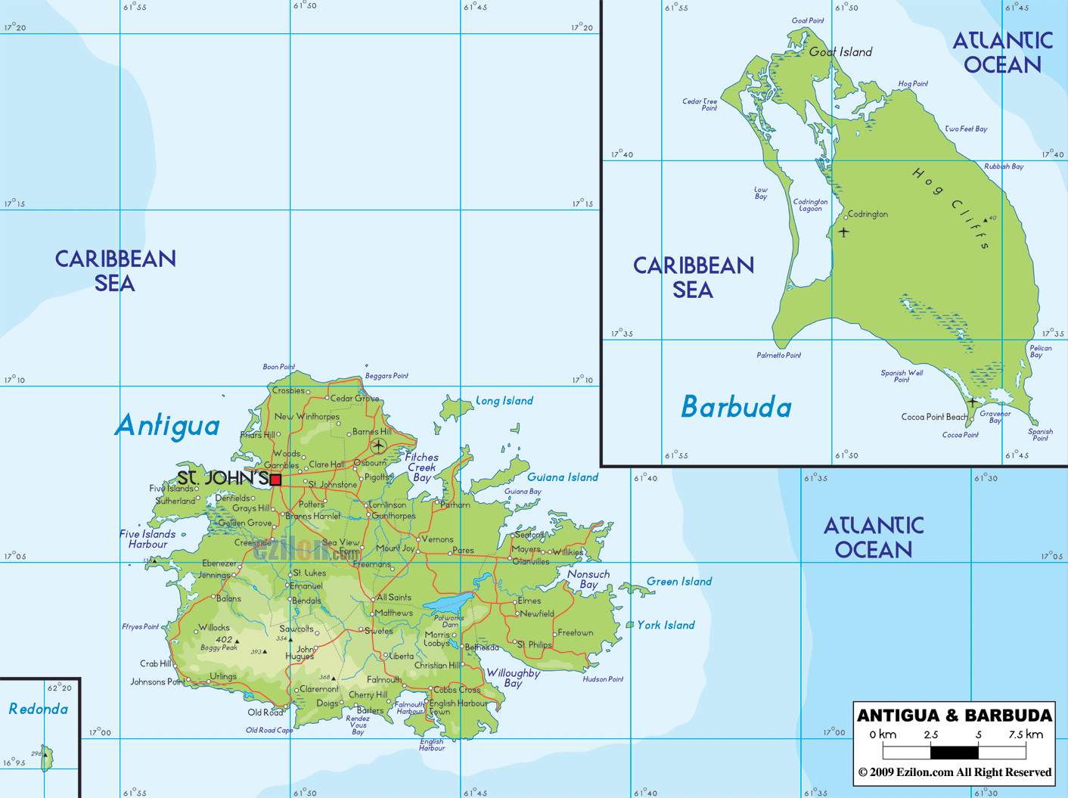
The capital of Antigua & Barbuda is St. John’s.

Slide 6
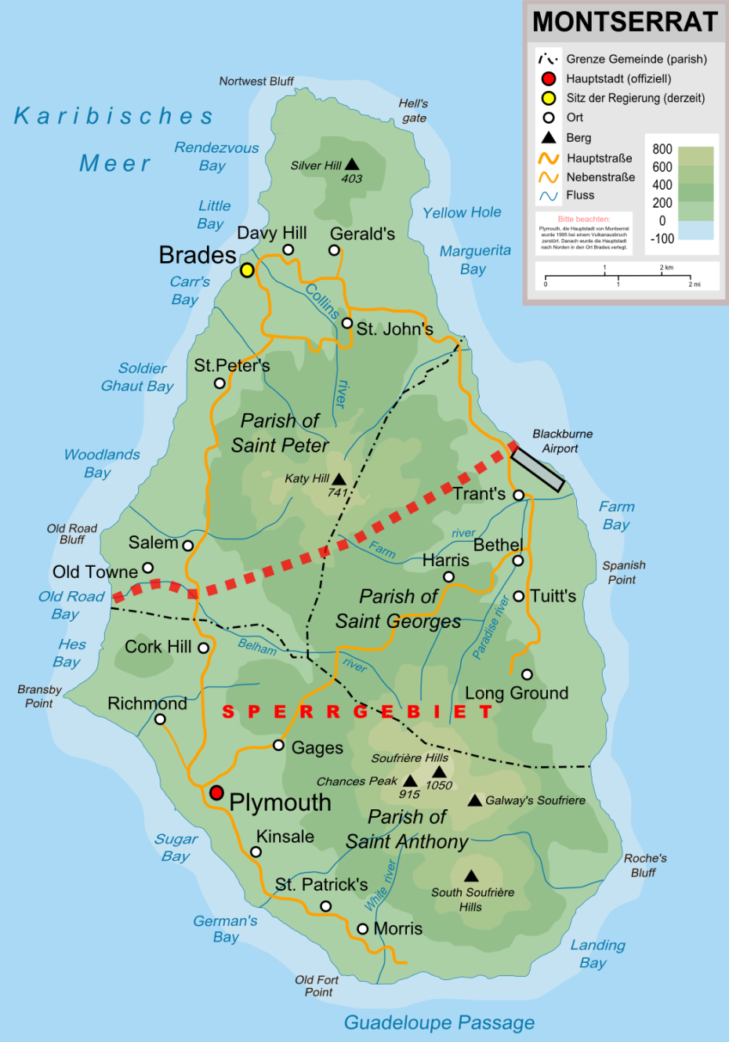
The capital of Montserrat is Plymouth.

Slide 7
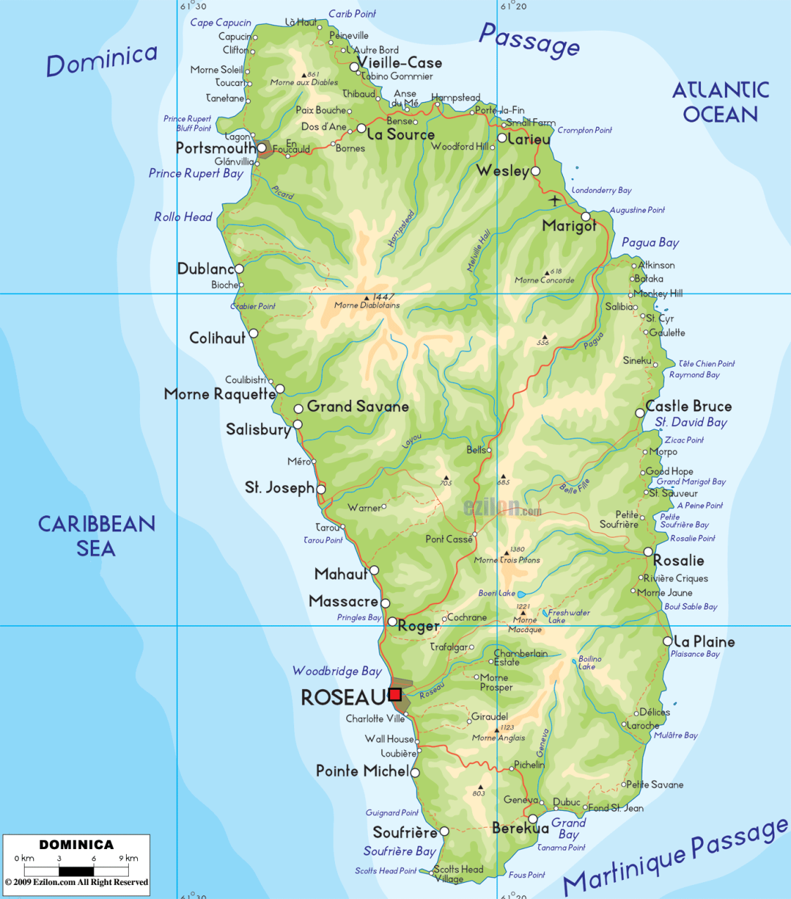
The capital of Dominica is Roseau.

Slide 8
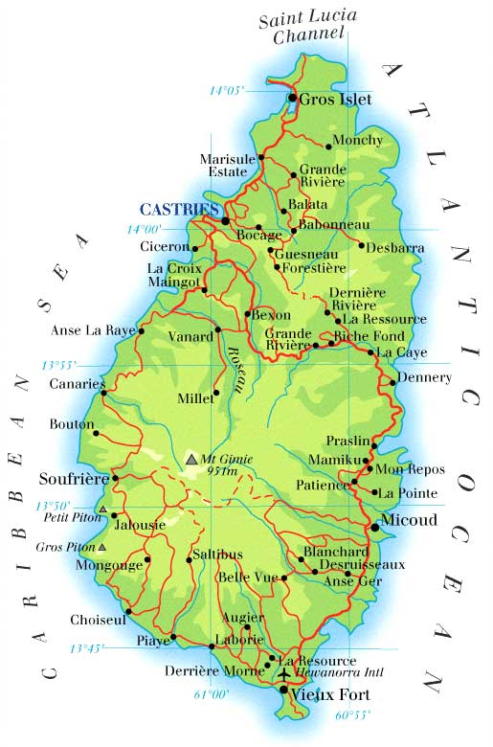
The capital of St. Lucia is Castries.

Slide 9
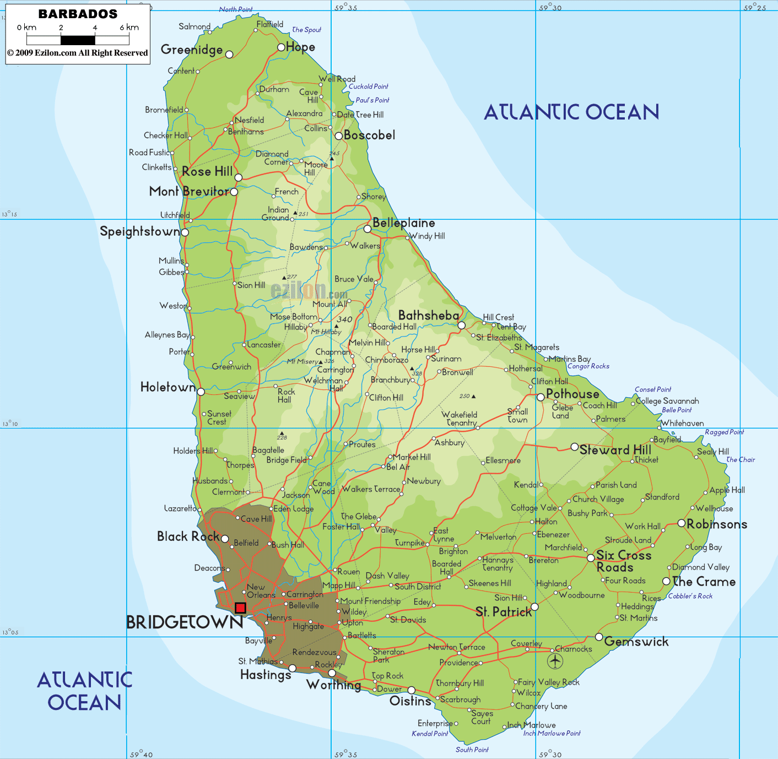
The capital of Barbados is Bridgetown.

Slide 10
The capital of St. Vincent & the Grenadines is Kingstown.

Slide 11
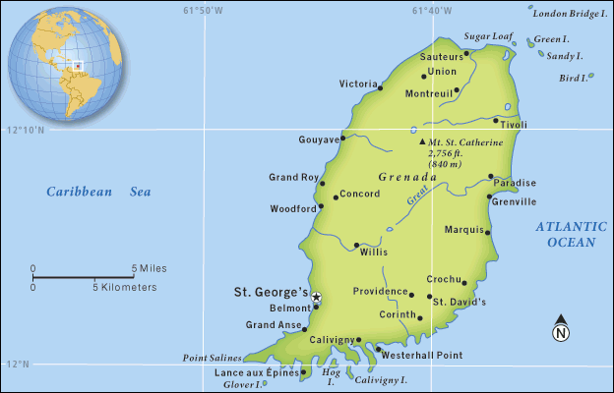
The capital of Grenada is St. George’s.

Slide 12
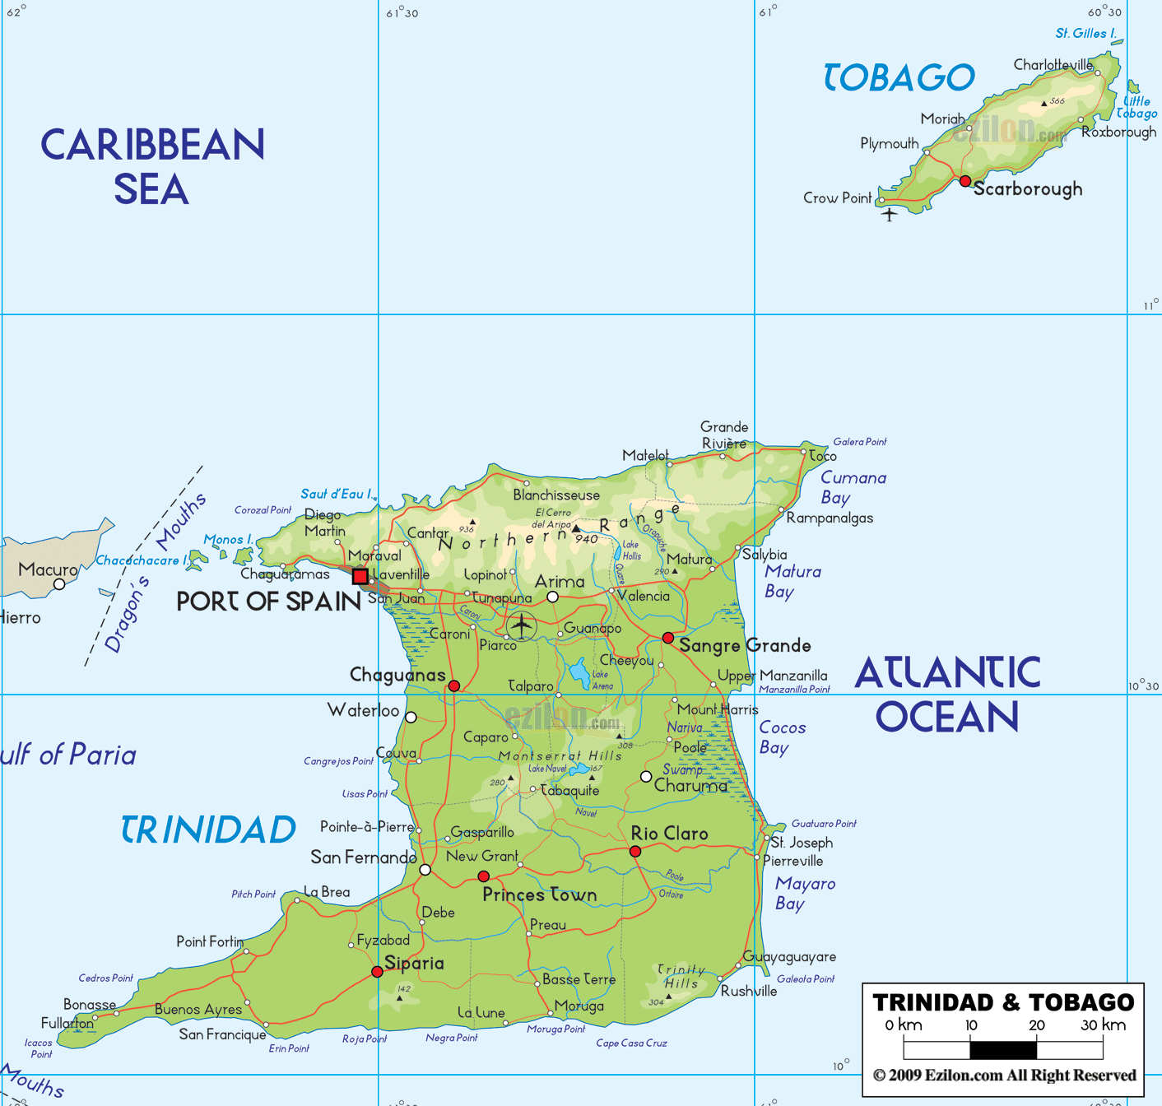
The capital of Trinidad & Tobago is Port of Spain.

Slide 13
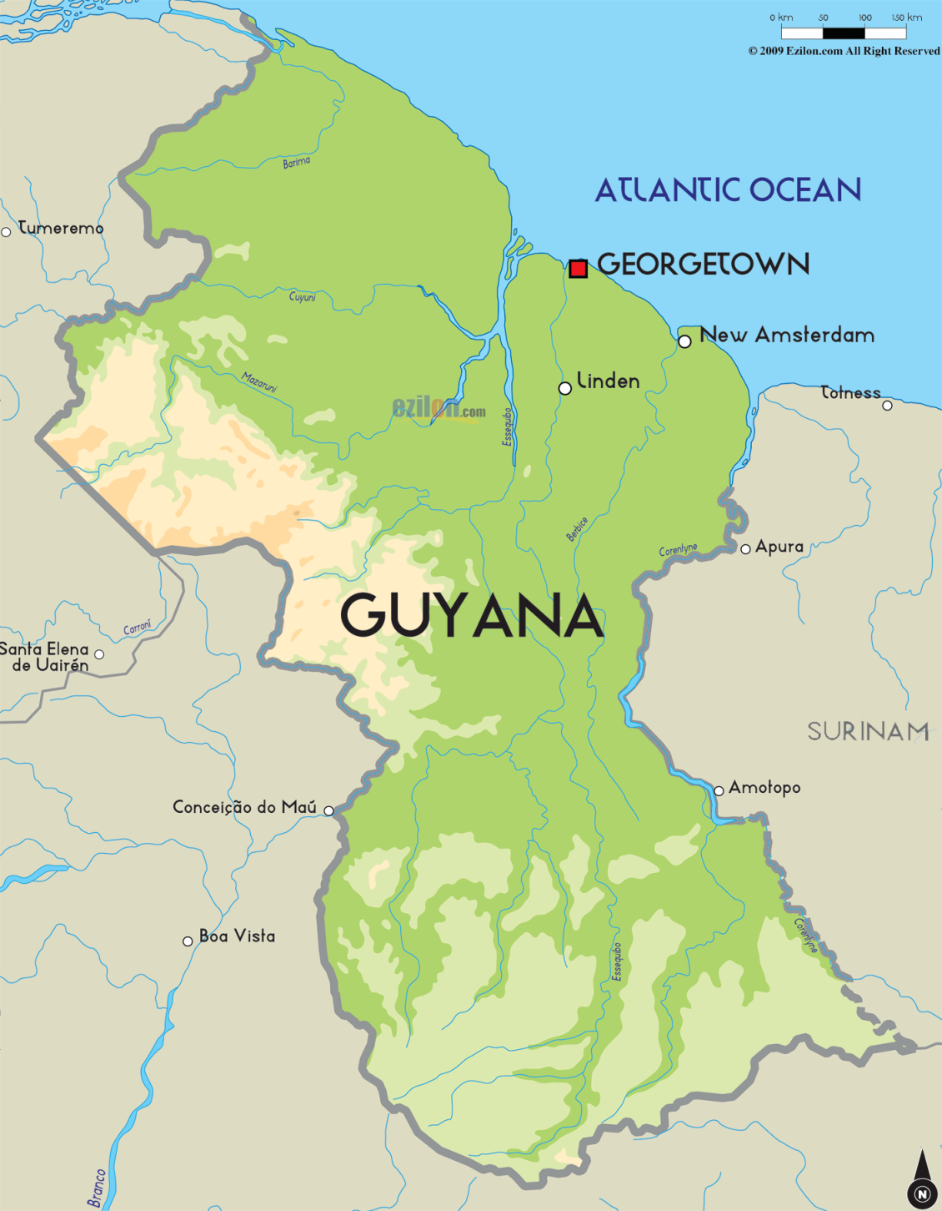
The capital of Guyana is Georgetown.

Slide 14
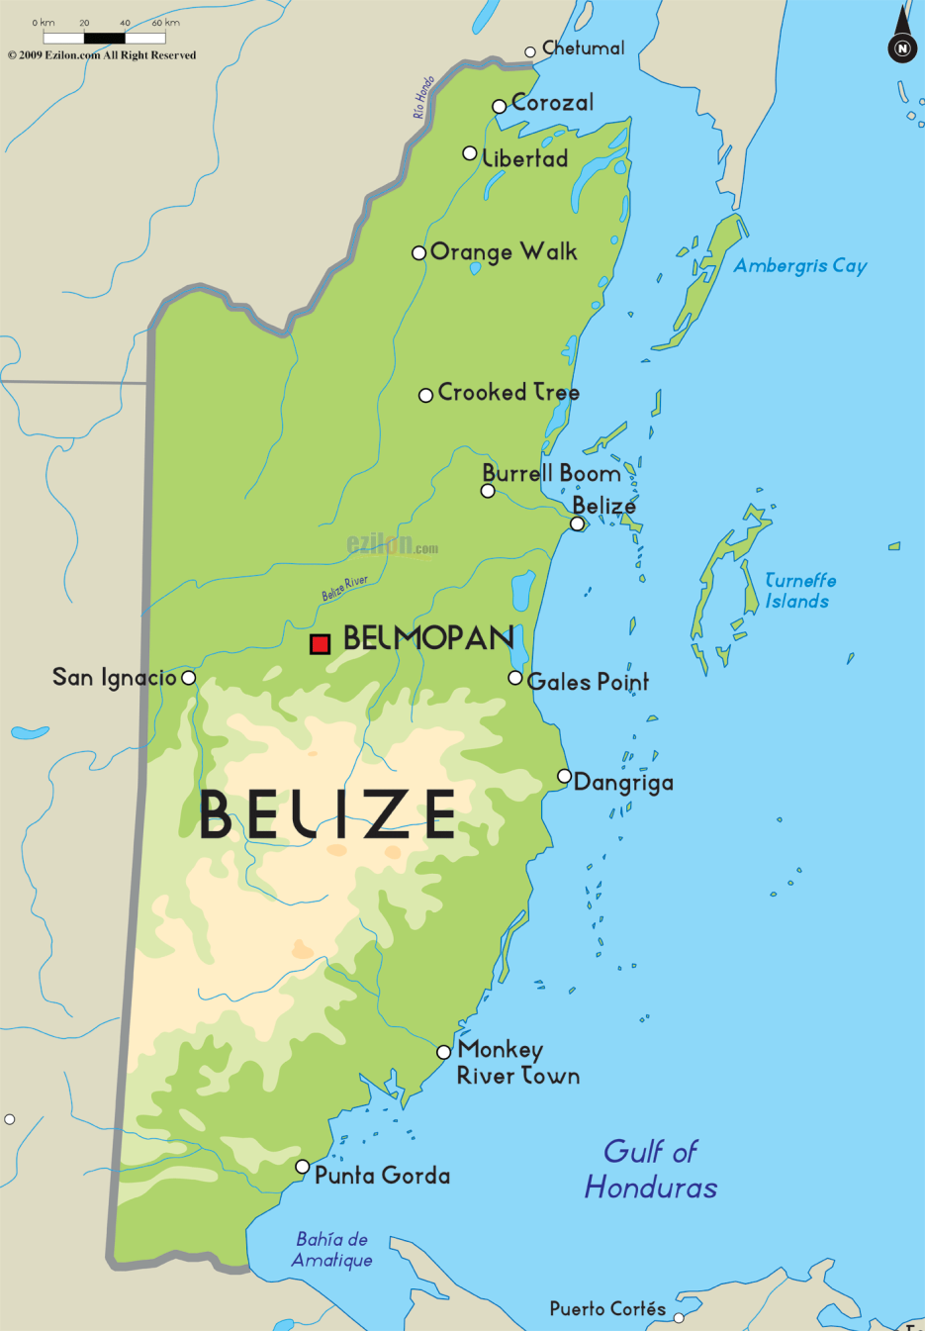
The capital of Belize is Belmopan.

Slide 15
Fun Facts
All of these Caribbean nations form part of the West Indies!
They are Anglophone countries.
Dominica, Saint Lucia, Saint Vincent & the Grenadines, Grenada, Barbados and Trinidad & Tobago form part of the Windward Islands.

