Slide 1
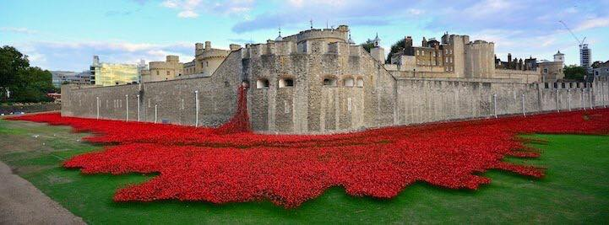
Look at the photos and describe what you can see
Do you recognize this monument ?
Where is it ?

Slide 2
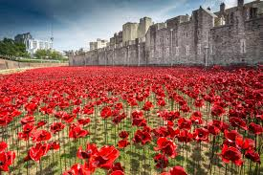
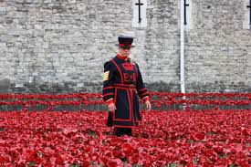
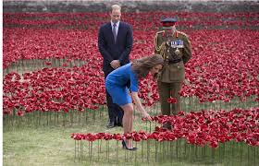
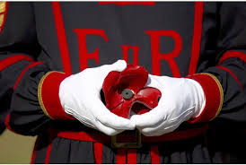
Who and what can you see ?
When ?
Why ?
A garden
A beefeater
A poppy / lots of poppies
A soldier
Vocab. Help :
Commemorate
Fall for the country
Armistice Day
Ceramic poppy
Artist : Tom Piper
The Moat : les douves

Slide 3
For more information :
http://www.bbc.com/news/in-pictures-29935592
http://www.britishlegion.org.uk/remembrance/ww1-centenary/poppies-in-the-moat

